Slide 1
Introductory Data Science and Machine Learning
CP1407
Lecture #2
Data Pre-Processing and Exploration

Slide 2
Lecture Overview
Dataset types
Dataset quality
Data Pre-processing
Pre-processing in Weka

Slide 3
Pre-Reading List
Pre-Lecture work (reading) for students:
Textbook (Data Mining: Practical Machine Learning Tools and Applications) – Chapter 2, Chapter 3
Han and Kamber (2012), “Data Mining: Concepts and Techniques” 3rd Edition. – Chapter 2, Chapter 3

Slide 4
Sample and Feature
Sample : individual independent recording of a real life object/event.
Feature : a specific property or characteristic of the data object.

Slide 5
Dataset Example
123, “John Smith”, “03/02/1990”, 20, “male”, 1.82, 78
Name
collected
Birthday collected
Age
calculated
Body height
measured
ID number, collected
Gender collected
Body weight
measured

Slide 6
Types of Learning
Supervised learning (classification)
Supervision: The training data (observations, measurements, etc.) are accompanied by class labels
Unsupervised learning (clustering)
The class labels of training data is unknown
Mary Bill
Jim
Mike Dave
Anne
John | Professor | 1 | ?
Notes:
Slide for body text

Slide 7
Dataset Errors
Precision: Fraction of correct classifications that are relevant.
Accuracy: Total number of correct classifications
Bias: Uncertainty in repeated measurements

Slide 8
Feature Types
Nominal, e.g. Gender (M, F)
A set of names: no concept of order nor difference
Ordinal, e.g. Grade (A, B, C, D, E)
A set of names: with order but no concept of difference
Numeric, e.g. Temperature in °C
A set of numeric values: both order and difference exist

Slide 9
Dataset Forms
Table of records
Numerical data matrix
Boolean sample-feature matrix
Ordered data
Data sequence
Spatial data
Graph-based data
Non record-based data

Slide 10
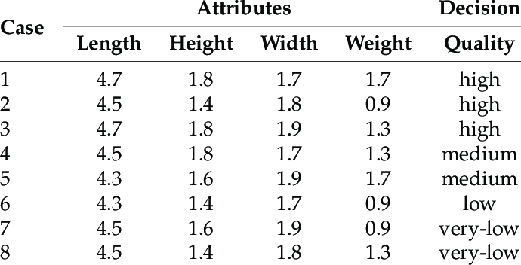

Examples
GGTTCCGCCTTCAGCC
CCGCGCCCGCAGGG…
Data Sequence
Data Matrix
Page1
link1
link2
Page2
link3
Page3
xxxx
yyyy
Page4
www
zzzz
Web Structure
Spatial Data

Slide 11
Data Properties
Size: amount of memory needed
Dimensionality: number of attributes
Sparsity: Data matrix has many values zero

Slide 12
Quality Indicators
Accuracy: data recorded with sufficient precision and little bias
Correctness: data recorded without error and spurious objects
Completeness: any parts of data records missing
Consistency: compliance with established rules and constraints
Redundancy: unnecessary duplicates

Slide 13
Issues of Data Quality
“Garbage in, garbage out!”
Clean the data before training
Algorithm tolerant to noise

Slide 14
Data Pre-processing
Understand the characteristics of data
Select suitable pre-processing methods
Visualise using graphs to reveal hidden patterns
Use summary statistics such as mean and variance

Slide 15
Missing Values
Value is missing in Data Matrix
Impute missing value as an average over nearest neighbours
Use a default for missing sample, e.g. set to 0

Slide 16
Transformation
Transform all values of a feature to other values
Reduces the impact of outlier values
Transformation using function e.g. log(x)
Normalisation e.g. map to a range [0 – 1]

Slide 17
Feature Selection
Reducing dimensionality by selecting a subset of attributes
Curse of Dimensionality e.g. are all 9600 dimensions for a 120x80 pixel image necessary?
Remove redundant or irrelevant features
Methods
Manually with common sense and domain knowledge
Algorithms such as PCA and ICA

Slide 18
Discretisation
Convert continuous feature values to categorical values
Reduces complexity of problem
Number of categories
Equal splitting
Split with highest accuracy
Continuous Feature
t₁
t₂
t₃
t₄
Categories

Slide 19
Subsampling
Selecting a subset of the given dataset
Reduces training time
The subset must be representative of the original data
Methods
Random sampling
Sample equally from each class
Data
population
Sampling
method
Selected
subset

Slide 20
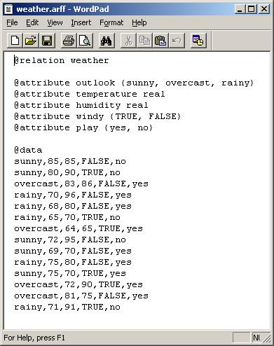
Weka ARFF format
Data set name
Numeric attribute names and types
Schema section
Categorical attribute name and values
Data section
One data record per line;
Values separated by “,”;
“?” represents unknown.

Slide 21
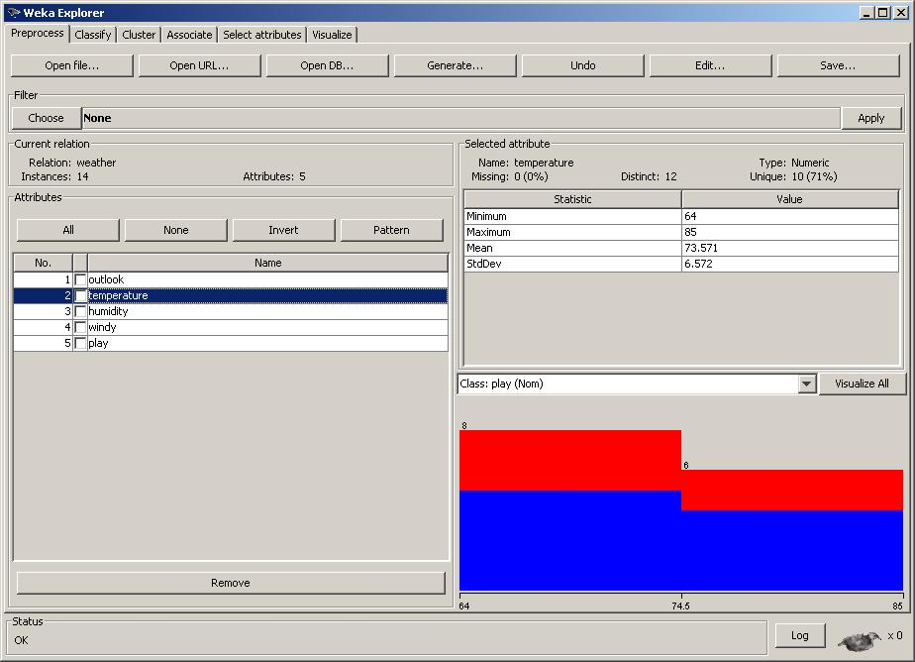
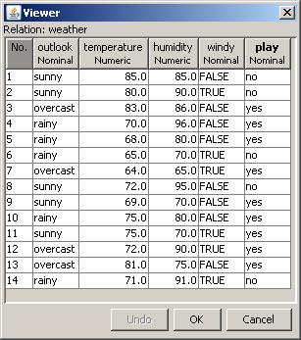
Weka Explorer
Summary
statistics
Visualisation of value distribution

Slide 22
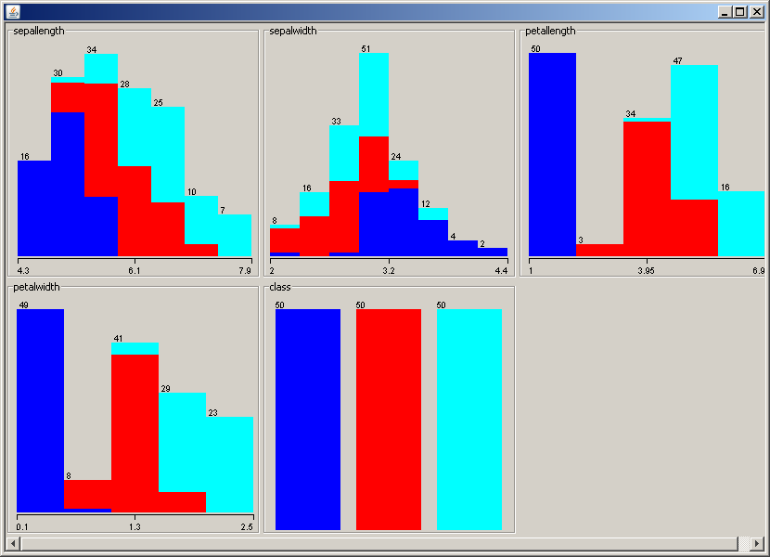
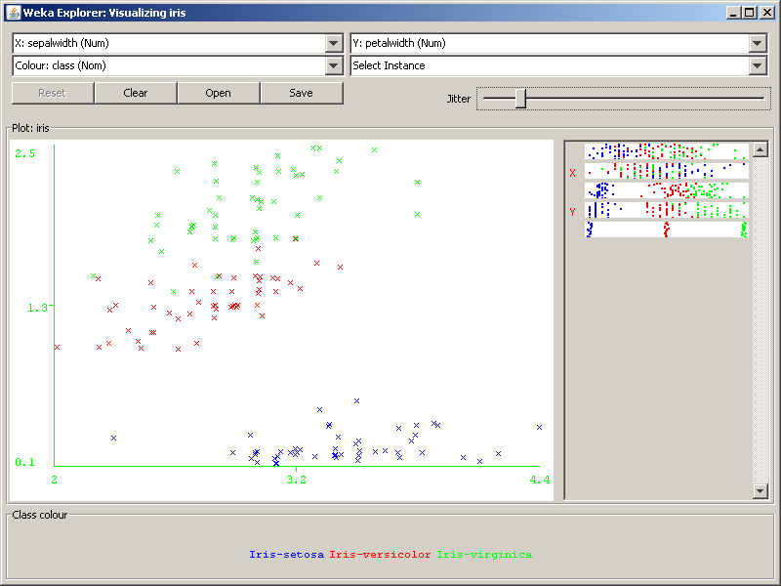
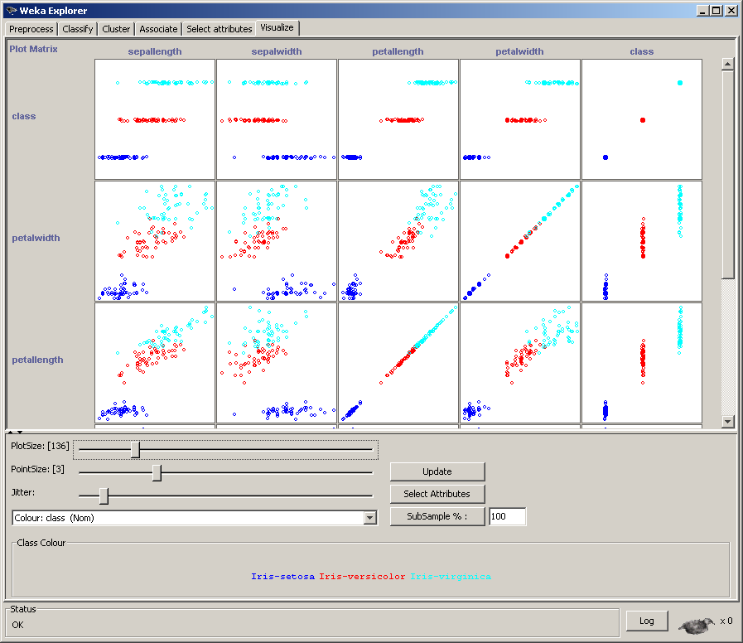
Data Visualisation in Weka

Slide 23
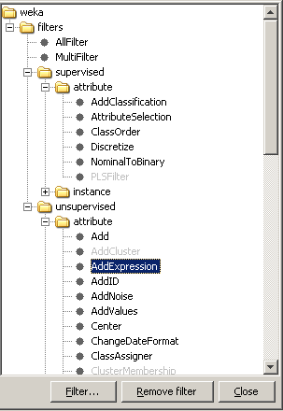
Pre-processing in Weka
Filters for pre-processing
Supervised/unsupervised
Feature/instance
Choose the parameters

Slide 24
Summary
Dataset are made up of features and samples
Data can be structured or unstructured
We must ensure quality of data
Feature selection can reduce computational costs
Weka is a software for machine learning

